Slide 1
Chapter 7-2: Authentication with IBM w3-id
Learning Bluemix & Cognitive
Bob Dill, IBM Distinguished Engineer, CTO Global Technical Sales

Slide 2
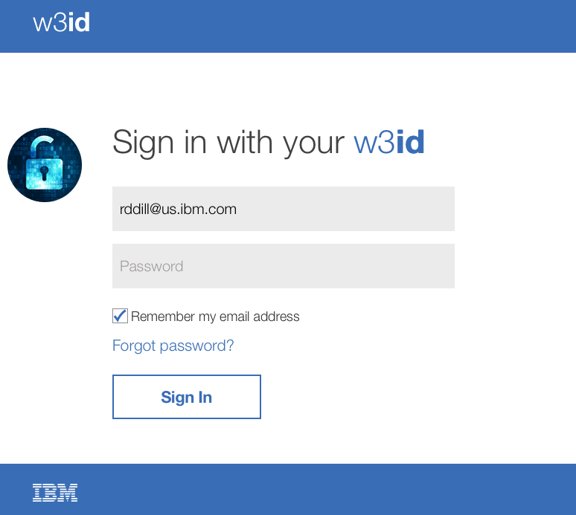
Chapter 7: Securing your application with IBM w3-id
Authorizing your application to use w3-id
Enabling your Bluemix application to use https
Implementing w3-id

Slide 3
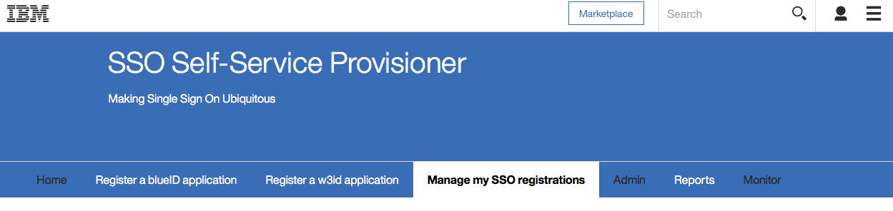
Enabling your application to use w3-id
Start here: https://w3.innovate.ibm.com/tools/sso/application/list.html
To create an internal app, click on “Register a w3id application”
To create a client-facing app, click on “Register a blueID application”
Sample NodeJS app from IBM CIO organization using w3-id (SAML)
https://w3-connections.ibm.com/wikis/home?lang=en-us#!/wiki/W7d38ca49a9b1_4048_8833_53626980363f/page/Node%20SSO%20with%20SAML

Slide 4
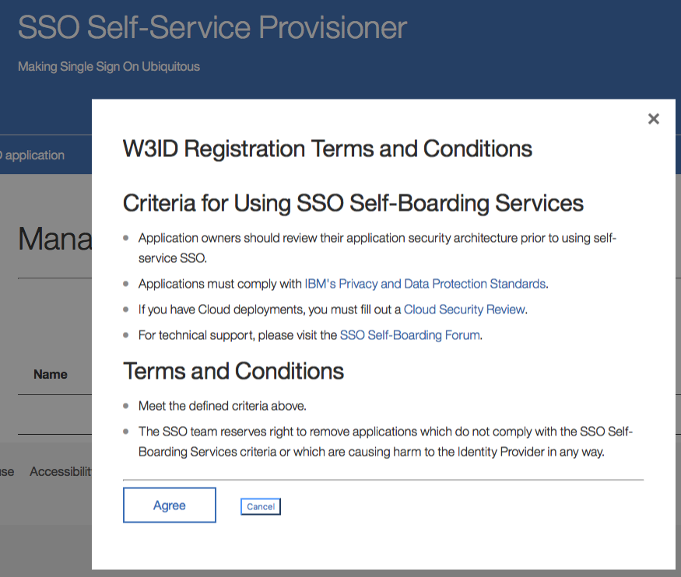
Register a w3-id application
1
Agree to the terms and conditions

Slide 5
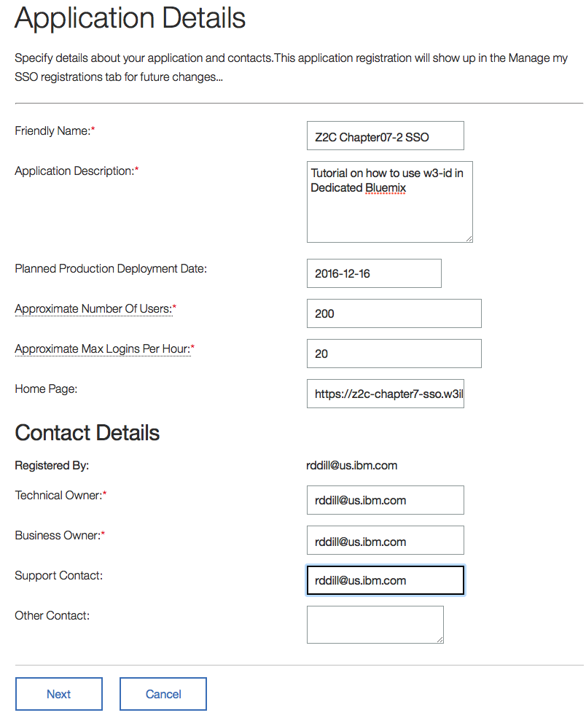
Register a w3-id application
2
2). Provide a reference (friendly) name for this request and a description of what this app will do. This simplifies your management later on.
Enter a planned deployment time in the immediate future
Put in a reasonable number of users. For this tutorial, use small numbers. I used 200 and 20 for the demo page for this chapter.
Put in the bluemix homepage url for your application. This is the ROUTE from the app dashboard in bluemix.
Put in your intranet id for the last 4 fields and press Next

Slide 6
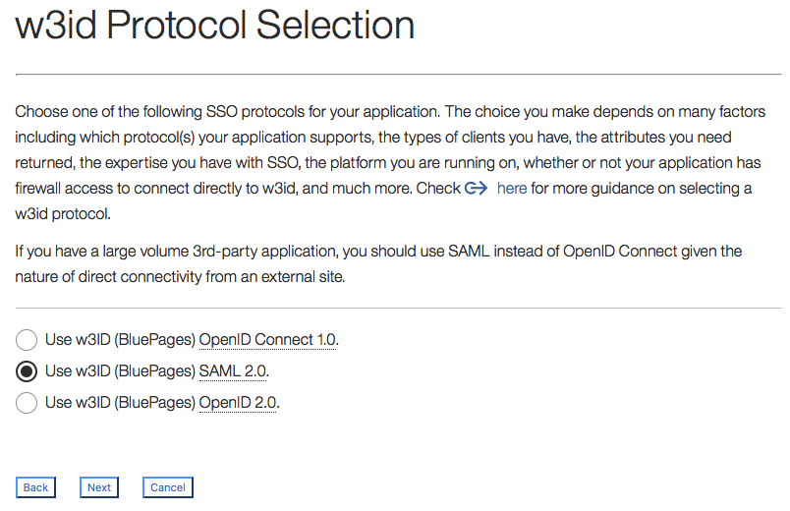
Register a w3-id application
3
3). Select w3-id SAML2

Slide 7
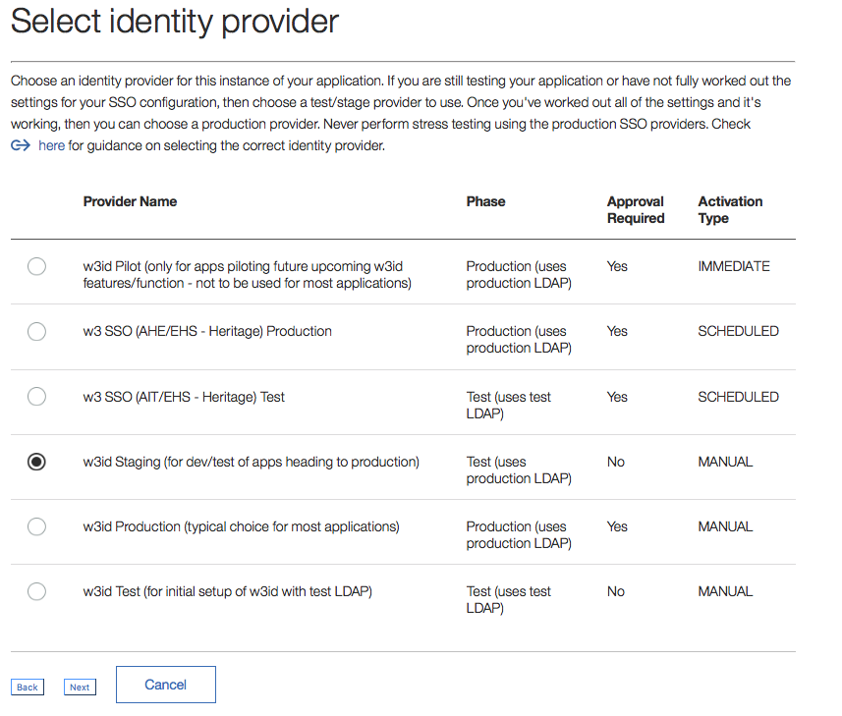
Register a w3-id application
4
4). Select test (not production)

Slide 8
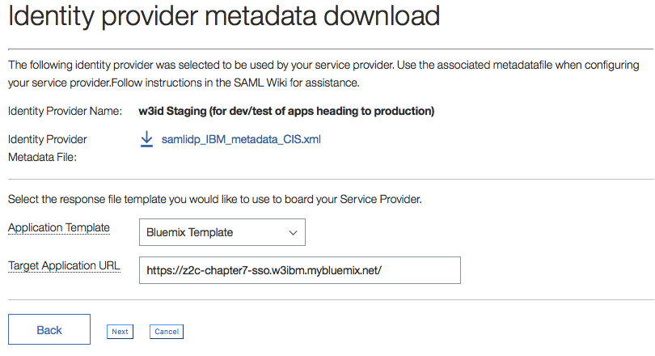
Register a w3-id application
5
5). Scroll down the application template and select the Bluemix template.
Enter your application URL as https

Slide 9
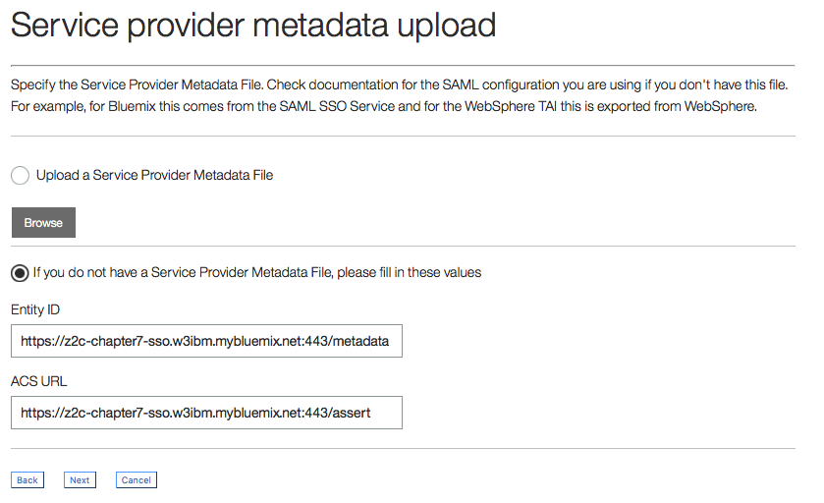
Register a w3-id application
6
6). Enter your bluemix route as https:// in both fields.
Entity ID in this example is :443/metadata. The only part you can change is “metadata”. If you change this, you’ll have to change the related code in your authenticate.js file
ACS URL is your callback path from the w3-id authentication process. The url ends with :443/assert. The only part you can change is “assert”. If you change this, you’ll have to change the related code in your authenticate.js file

Slide 10
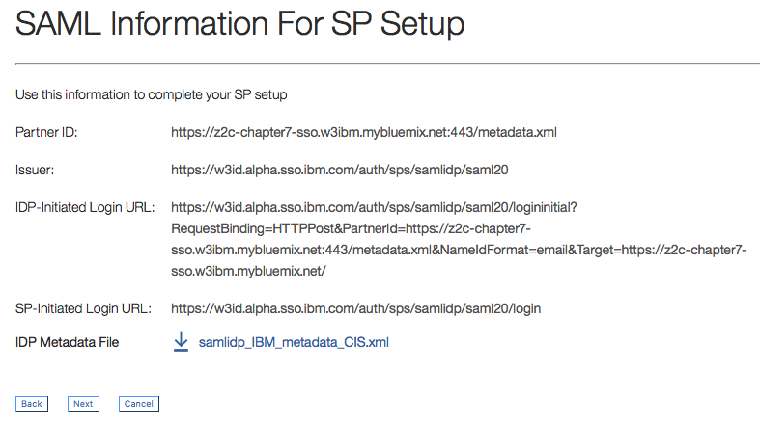
Register a w3-id application
7
7). Use this information in the index.js file and in the authenticate.js file in the var sections where you build your login url.

Slide 11
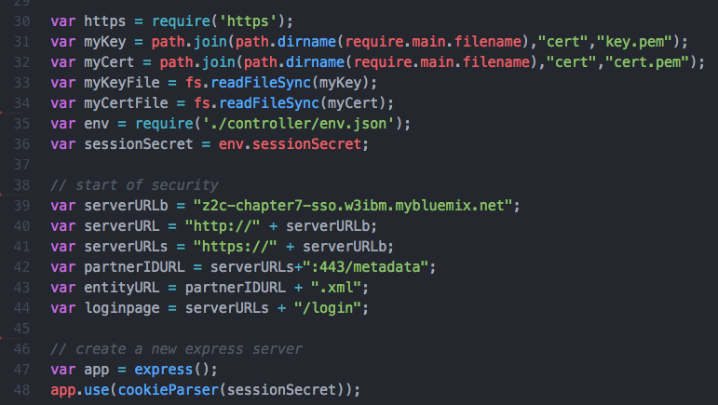
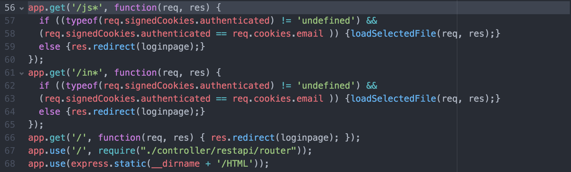
Set up index.js
On the left, we establish the variables which will be used in this chapter. the key file and certificate file are the same as the ones created for Chapter 7.
Below, we add a series of app.get paths. The sequence IS important and all of the new paths must precede the app.use statement for the router and the app.use statement for express.static.
res.cookies.authenticated is only visible to the server and is only present when the
To create key and certification files, use the following commands
openssl genrsa -out key.pem
openssl req -new -key key.pem -out csr.pem
openssl x509 -req -days 9999 -in csr.pem -signkey key.pem -out cert.pem

Slide 12
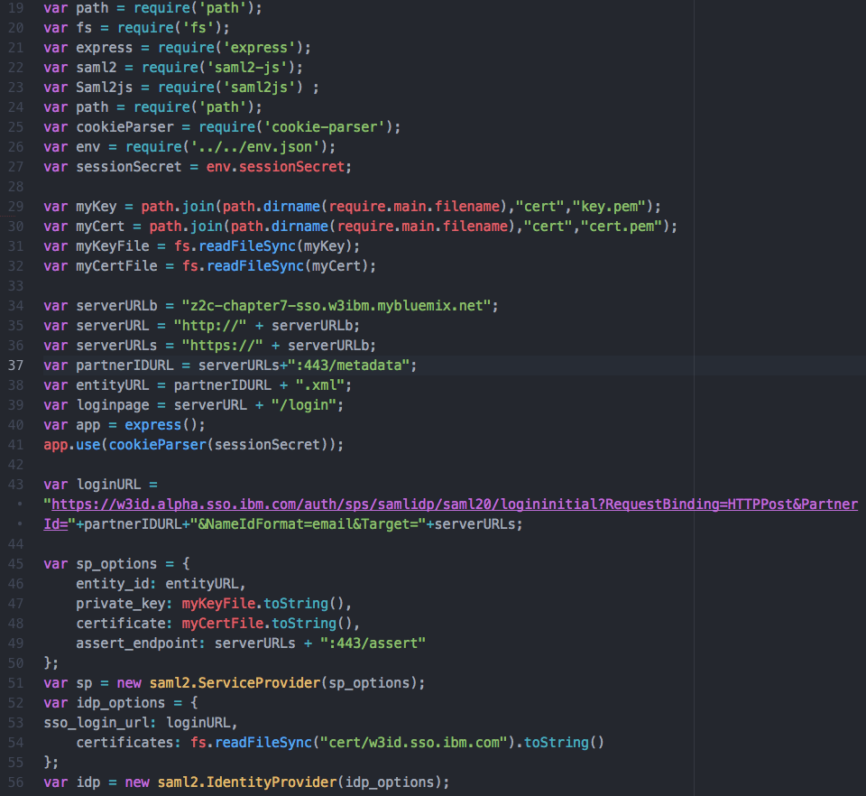
Creating the authenticate routines: the variables
SAML to get security basics
cookie-parser to send info back to server
Retrieve key file and certificates
Match to paths from w3-id request
Build log in URL from parts
Create SAML options for callback
Create SAML options for certificate

Slide 13
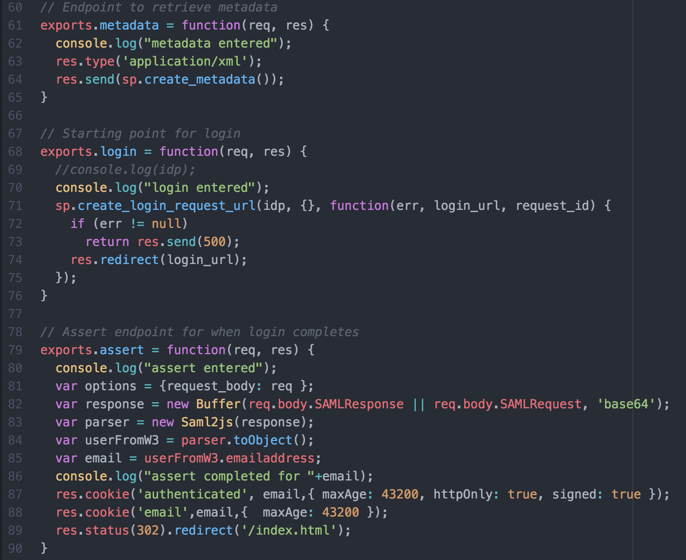
Creating the authenticate routines: the functions
Metadata dynamically creates information for w3-id which identifies your application on bluemix.
login initiates the authentication request to w3-id.
idp holds your certificate
login_url is returned based on the loginURL provided in dip
assert is called only on successful completion of the w3-id authentication request.
The userFromW3 object has a great deal of useful information and is worth inspecting
two cookies are set. authenticated is only visible to the server where email is visible to the client (so you can use the email address with things like the blue pages API to retrieve a picture of the person who’s logged in.

Slide 14
The Plan: 30 minute Chapters with an hour or two of practice
The Story, Architecture for this app
Setting up Bluemix
Building your first Watson App (Watson Speech to Text)
Getting Watson to talk back (Watson Text to Speech)
Understanding Classifiers (Watson NLC)
Creating a custom dialog with Watson (custom Q&A, session management)
Authentication (puts C2 thru 6 together)
Alchemy News (Watson Alchemy)
Visual Recognition and Images (Watson Visual Recognition)
Watson Conversations (Watson Conversations)
Retrieve & Rank (Watson Alchemy + Retrieve & Rank)
Getting started on my first client prototype Design Thinking, Stories, Architecture, Keeping it simple
Supporting Complex environments Public Bluemix and Docker
Supporting Complex environments II Bluemix Dedicated and CloudFoundry
Creating an Inference Engine Our Inference Engine in "R"
Finding solutions Integrates C1-10, 13-15)
BlueMix, Watson and Mobile (TBD)
September-October
4Q

Slide 15
Chapter 8: Understanding Alchemy News
Learning Bluemix & Cognitive
Bob Dill, IBM Distinguished Engineer, CTO Global Technical Sales

